Slide 1

The Student helping website

Slide 2
Table of contents
Introduction
Our Goal
Features
Web View
Future
Conclusion
Introduce our Project
What is our goal?
Describe many feature
Next plan for this project
Result
Responsive in different-different devices

Slide 3
01.
Introduction

Slide 4
Welcome to our project Er Station, the main aim of our project is to help the students and provide the study materials for free. Here you can create your personal profile and then our website provide your department related materials and software. It is easy to search your study materials. Many students do not know How they have to download all these stuffs (like notes, previous year question, question bank etc.) and how to do it, so we have created a website with the name ‘Er Station’ which has all the study materials and software available or how to download it. It will be given and we will try our best so that the students do not have to face any problems regarding the study material .

Slide 5
02.
Our Goal

Slide 6
Our goals
Goal 3
Goal 2
Goal 1
Finding Job
Skill Development
Free Resources

Slide 7
03.
Features

Slide 8
Features
Software Download
UI Dashboard
Mobile Responsive
Easy to Access
User Support & Feedback
Study Material Download

Slide 9
04.
Web View

Slide 10
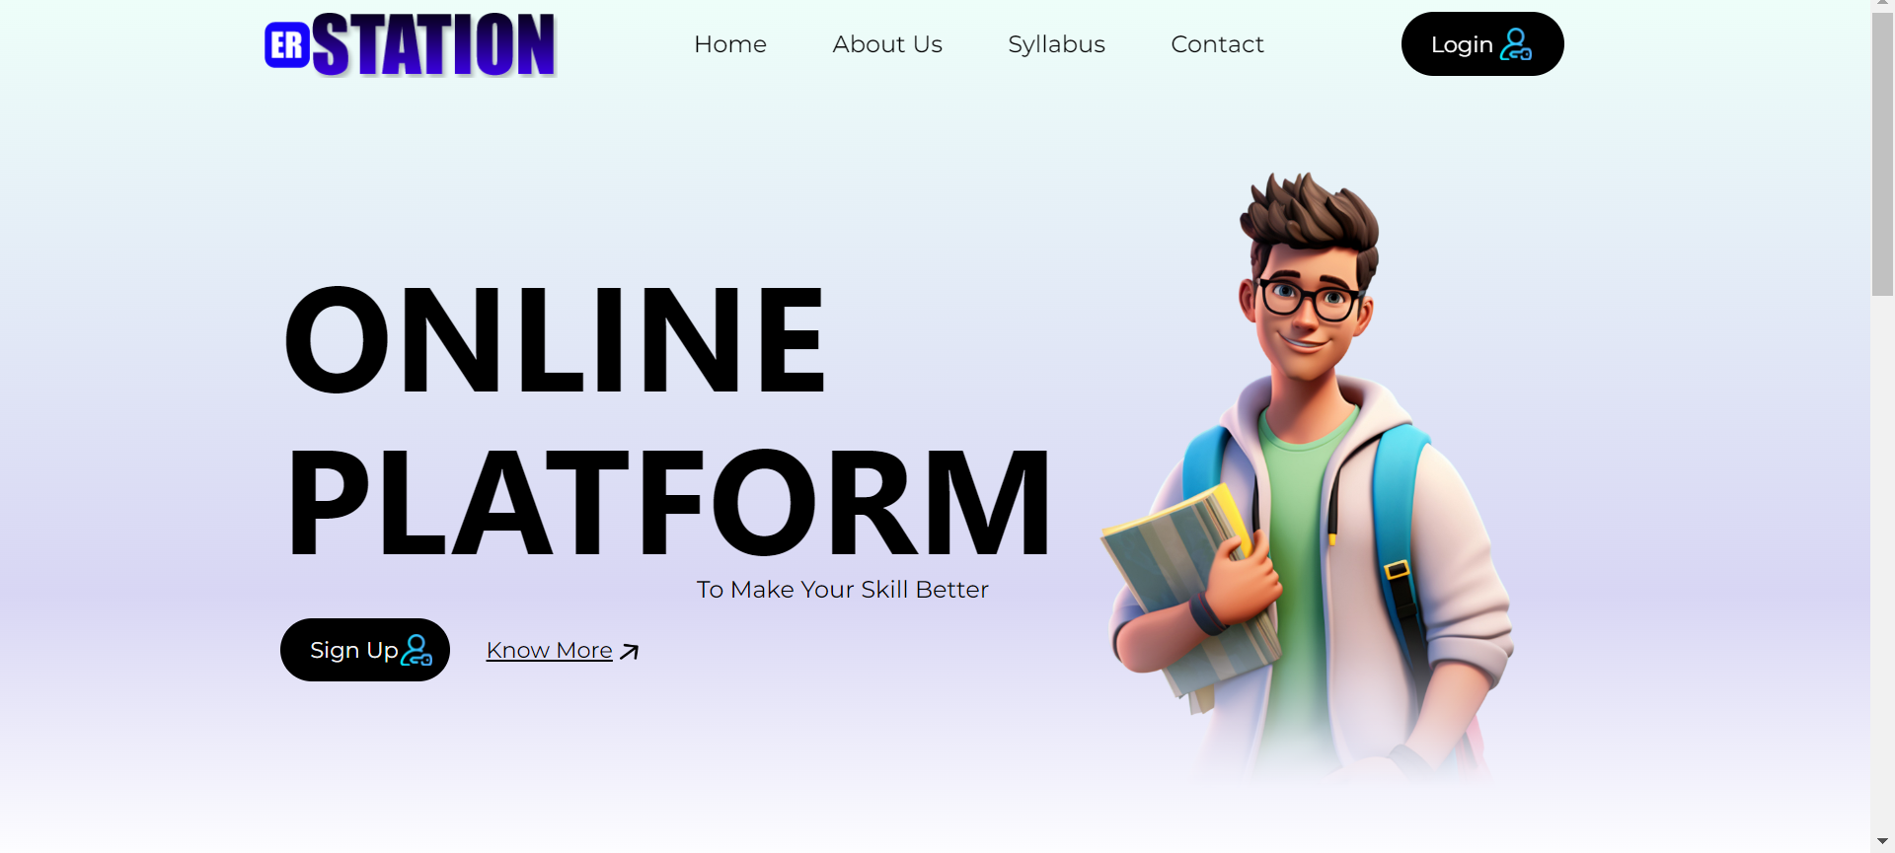
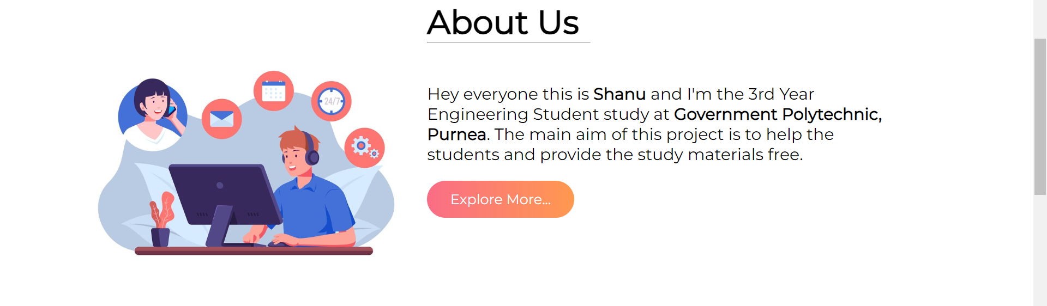
Desktop View

Slide 11
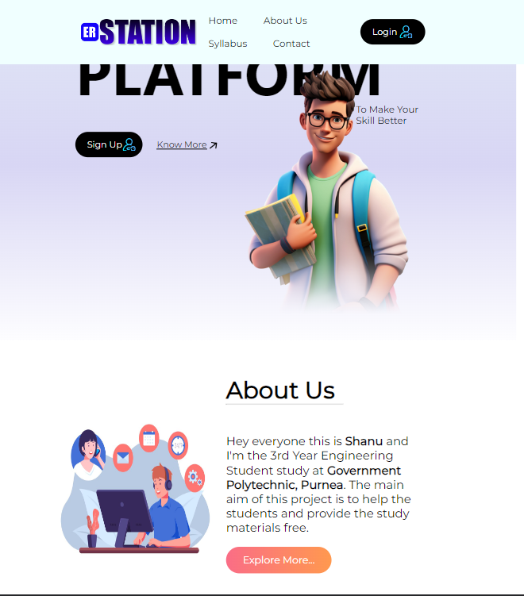
Tablet View

Slide 12
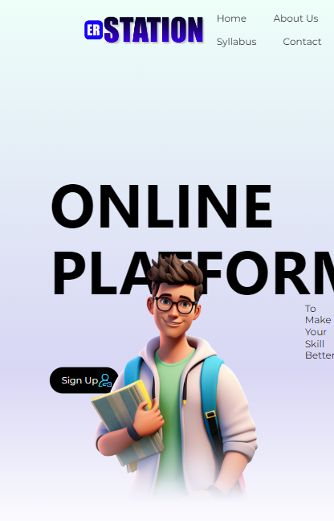
Mobile View

Slide 13
05.
Future of Project

Slide 14
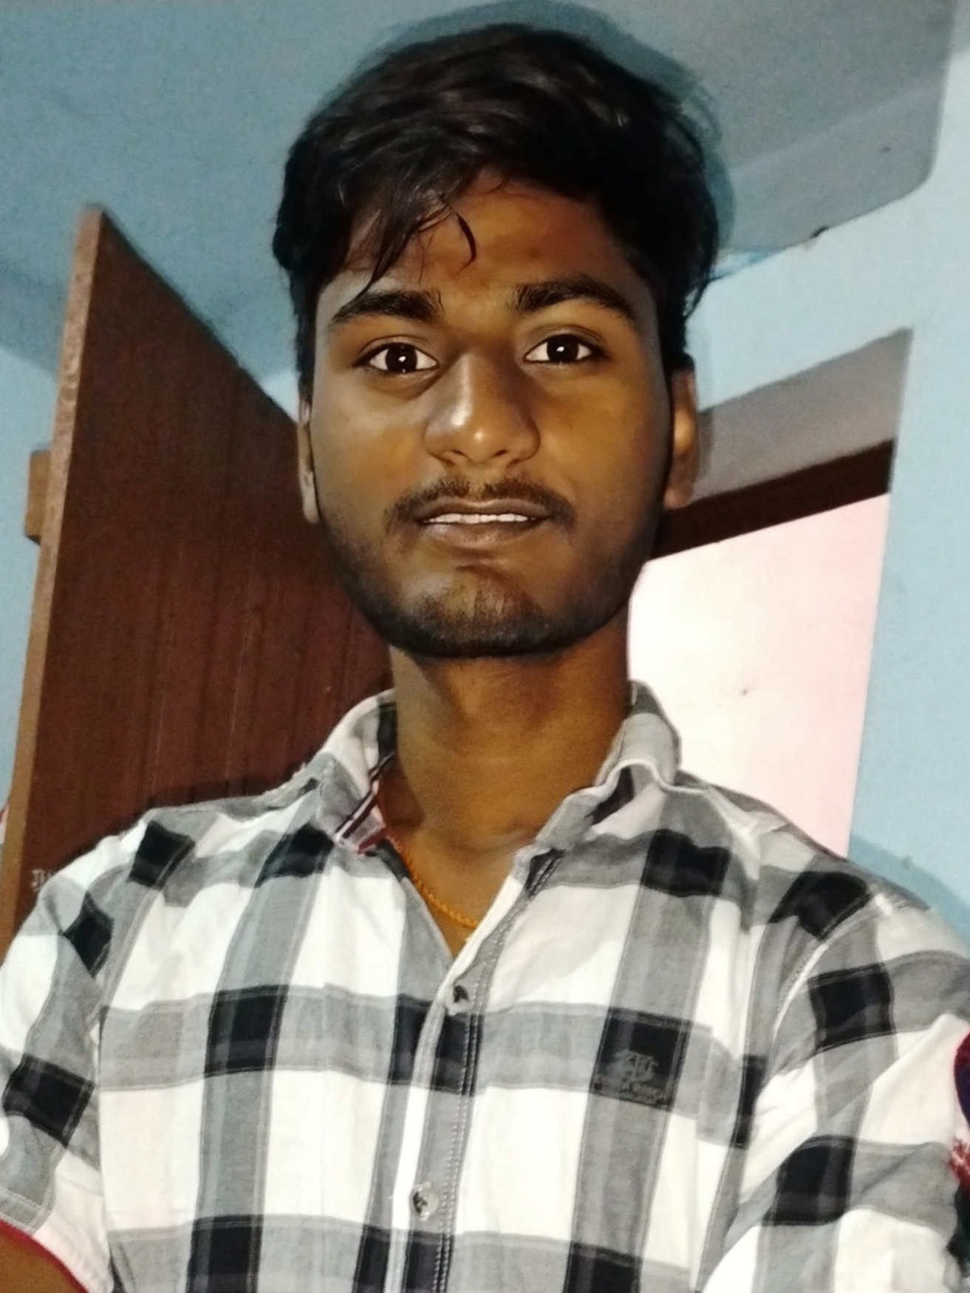
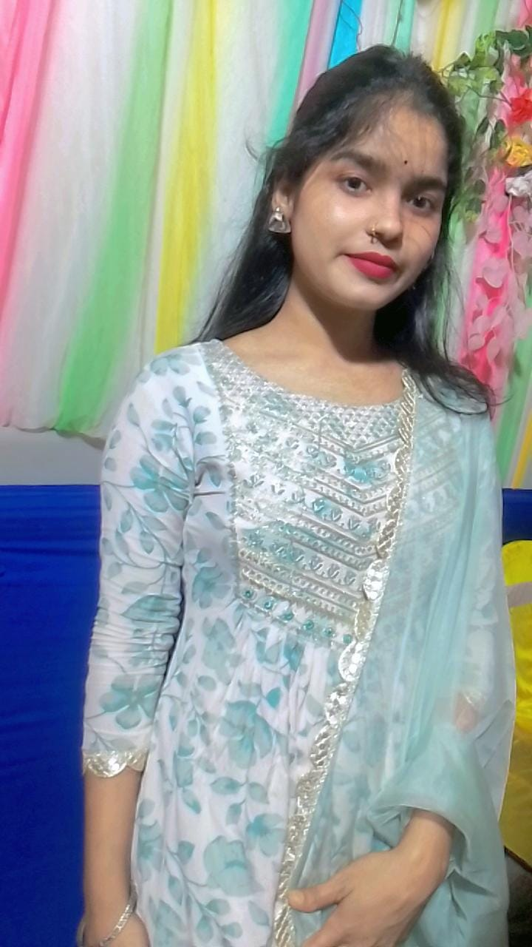


Our team
Shanu Kumar (611191821025)
Puja Kumari (611191821024)
Rajveer Singh Ranawat (611191821028)
Deepak Kumar Yadav (611191821003)

Slide 15
06.
Conclusions

Slide 16
Thanks!
Do you have any questions?
printf0007@gmail.com
erstation.com

